Slide 1

hUSTle HuB
Building Stable Lives

Slide 2
The Discovering of the problem
A lot of people have a hell of a time in finding manual jobs/work, without connections its very hard to get a hustle these days.
Earning a living for people who have no University Education, the manual laborers.
Going for a whole week without a job opportunity also is a challenge.
Finding manual laborers is difficult around Nakuru.

Slide 3
Objectives
Main Objectives
To having a mobile Application that will help people to connect to manual laborers providers for manual work.
To have a friendly mobile application that will be easier and simpler to use for everyone, i.e. the educated and illiterate people.
Specific Objectives
Develop a System for people to help each other, mostly in times of pandemic.
To have a system that will connect, (youths) to acquiring jobs without having to engage themselves into criminal activities.

Slide 4
Data Collection Methods
Interviews:
I mainly used interviews in may data collection which come in handy, as I managed to get good feedback from the three persons I managed to perform interview on.
Some of the responds suggested that an online platform where one can connect and find a hustle is just what they need. The mobile application online platform will be able to reach every one, hence one can acquire a day job in his comfort of his house.
A suggestion was to also have a SMS kind of notification to alert what kind of job have been posted and the cost and the person who have posted the job.

Slide 5
Personas
Name: John Matthew
Age: 28
Residence: Nakuru, Kampi Ya Moto
Education: High School
Occupation: Hustler
Marital status: Single
Goals:
To be able to provide his basic needs without relying to anyone
To start a business and also have a family
Frustrations:
Lack of jobs and connections
Lack of proper technology to help the non-educated.
Name: Kamau Joseph
Age: 43
Residence: Nakuru, Rafiki
Education: Technical Collage
Occupation: Foreman
Marital Status: Married 2 children
Goals:
To Provide Jobs to youths
To create more job opportunities
Frustrations:
Finding many youths in crimes

Slide 6
User Stories
John
- John first need to provide a phone number and email for registration purpose and also name and location.
After registration John is able to view open job opportunities around the hood.
John needs to check the open opportunities every morning and indicate His Interest by clicking Apply.

Slide 7
User Stories
Kamau
Kamau need to be able to register to the system by providing required information and most importantly not leaving out the Phone Number.
Kamau should be able to post any open work opportunity before 7:00 AM in the morning.
In Kamua details there should be a star rating and reviews by John this will help indicate how reliable Kamau is.
Kamau should indicate the payments for every job posted every single day, The time it will take and the open places.

Slide 8
Solution Valuation
Possible solutions
Creating a design to which both Kamau and John can interact and one can post for an open job, and John can check for open job in the neighborhood
Mobile Application which is easier to use for all people with capabilities of sending Sms for available jobs opportunities.

Slide 9
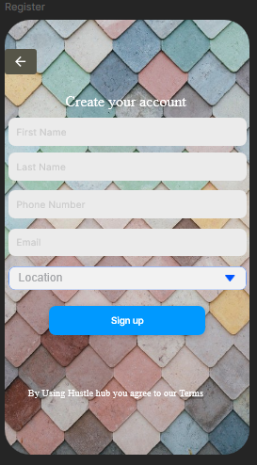
The Flow
John and Kamau both registers by providing their requested personal information's. Some important information include Providing Location and Phone Number.

Slide 10
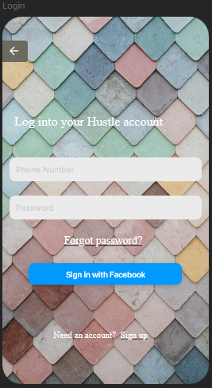
John login using His Phone number and a password after registration in our application

Slide 11
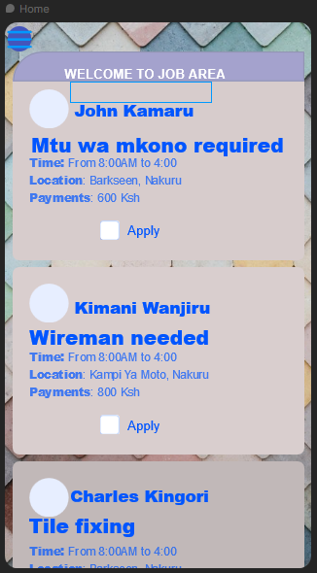
After login he is directed to a page which contains open jobs and the person who have posted the job, all filtered according to the His provided location.

Slide 12
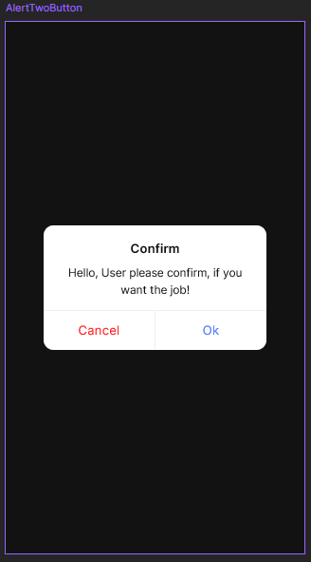
John clicks on his preferred job and is directed to the details of the job and the person who posted the job(Kamau). John finally can then apply to show interest of the job, a pop up alert shows up for confirmation.

Slide 13
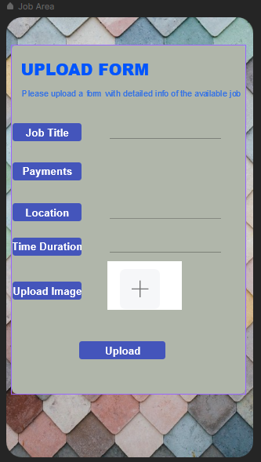
Kamau after login he can post a job indicating the period of the work, the payments, location and open places available.

Slide 14
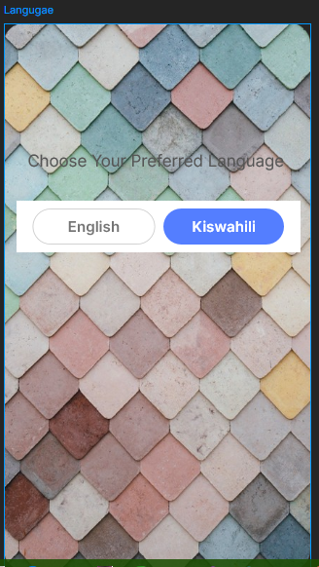
Also the Users can choose their preferred Language

Slide 15
Use case Diagrams
Hustle Hub
Sign Up/Create Account
Login
Employee(Job Seeker)
Redirecting Home Page
Edit profile
View Jobs/Homepage
Post jobs
Password/Language change
Sign Out
Employer

Slide 16
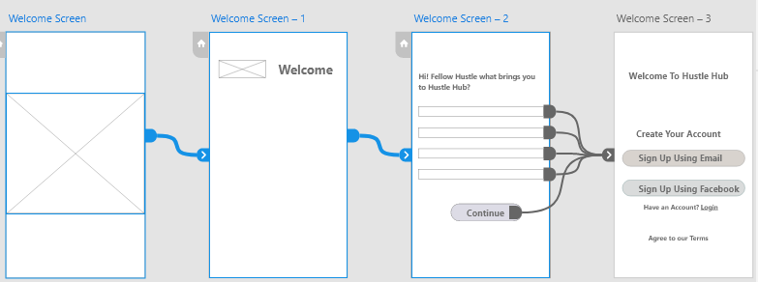
Wireframes/ Low Fidelity Prototype

Slide 17
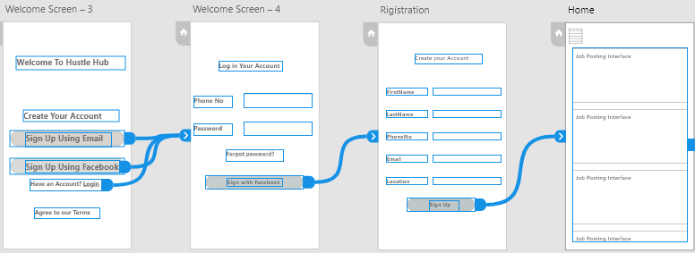

Slide 18
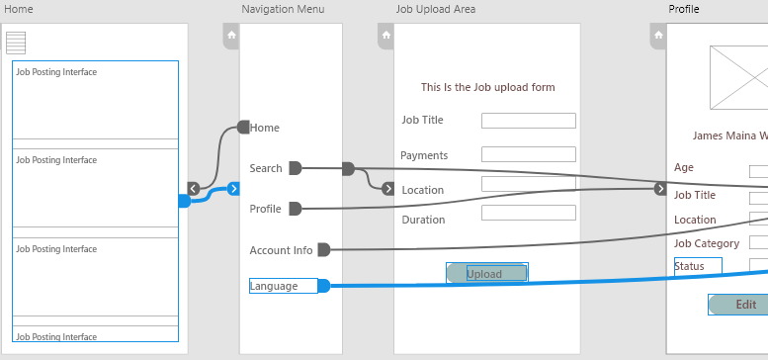

Slide 19
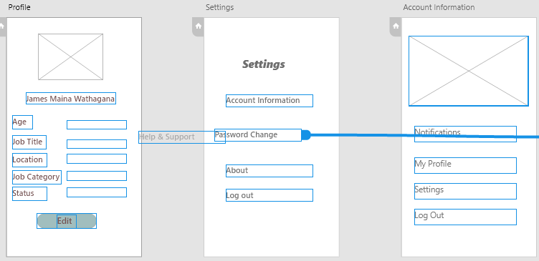

Slide 20
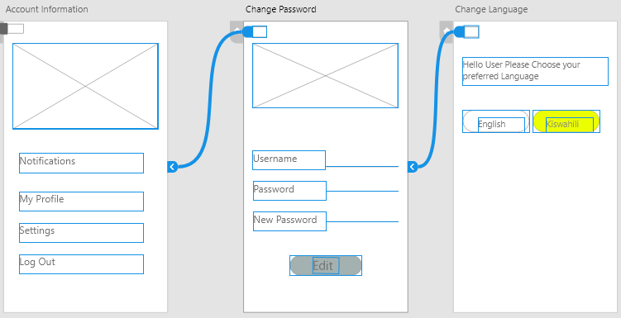

Slide 21
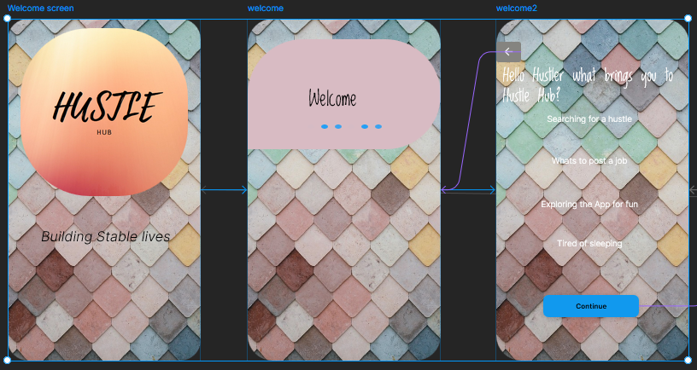
High Fidelity Prototype

Slide 22
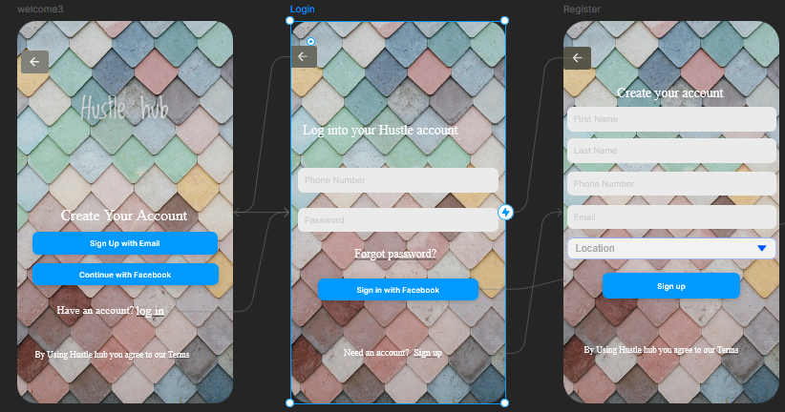

Slide 23
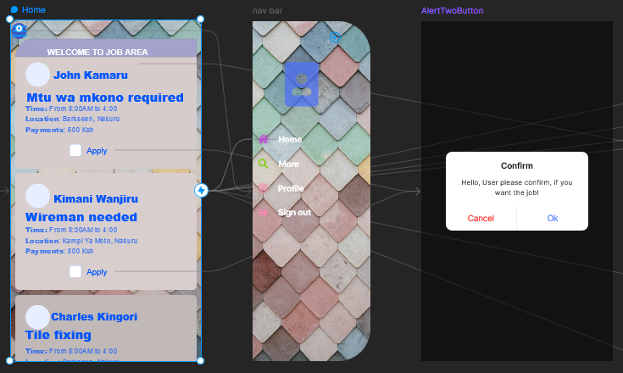

Slide 24
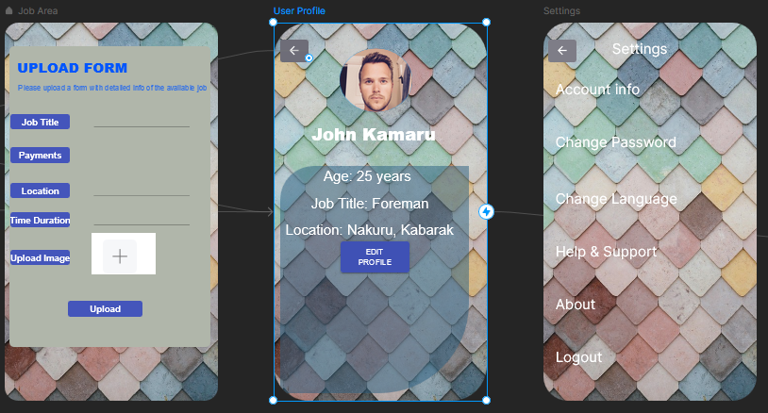

Slide 25
